Slide 1


Slide 2
Overview
01 | Hindrances to Church Progression
02 | The Need for Critical Review
03 | Benefits of Conducting a SWOT Analysis
04 | Conducting a SWOT Analysis
05 | Designing the Strategic Plan

Slide 3
Hindrances to Church Progression
Lack of Missional Focus
Unbridled Conflict
Traditional Worldview and Methods

Slide 4

The Need for Critical Review
Organizations need periodic critical review
The world is constantly changing
Methods become outdated and irrelevant
For the Church, the message must remain the same, but our methods must evolve
Critical review is an uncomfortable, but necessary process

Slide 5
SWOT Analysis: Definition, Rationale, Benefits
Definition: A tool that aids in the structured evaluation of an organization’s strengths, weaknesses, opportunities, and threats

Slide 6

SWOT: Definition, Rationale, Benefits
Rationale: An organization or business needs to have an objective knowledge of how well it is doing in comparison to its competition, its own potential, or alignment with its own mission

Slide 7

SWOT: Definition, Rationale, Benefits
Benefits: Conducting a SWOT analysis helps to reveal critical information about the organization that may be essential for planning its future objectives or managing its current realities

Slide 8
Conducting a SWOT Analysis
This method or approach is very engaged and time consuming, but it yields the best and most plentiful data to work with!
The pastor cannot unilaterally write a strategic plan for the church. That’s his/her plan, if the congregation is not involved.
A SWOT analysis reduces the subjectivity of the planning process and “forces” us to deal with obvious trends and themes

Slide 9

Conducting a SWOT Analysis
Two approaches could potentially be used to obtain the data from a SWOT analysis
Small group discussions (focus groups)
Develop or utilize a survey instrument (such as SurveyMonkey.com)
SWOT will generate a lot of data that will need to be sorted and analyzed to identify trends and themes, from which valuable information can be extracted to aid in the development of the strategic plan

Slide 10
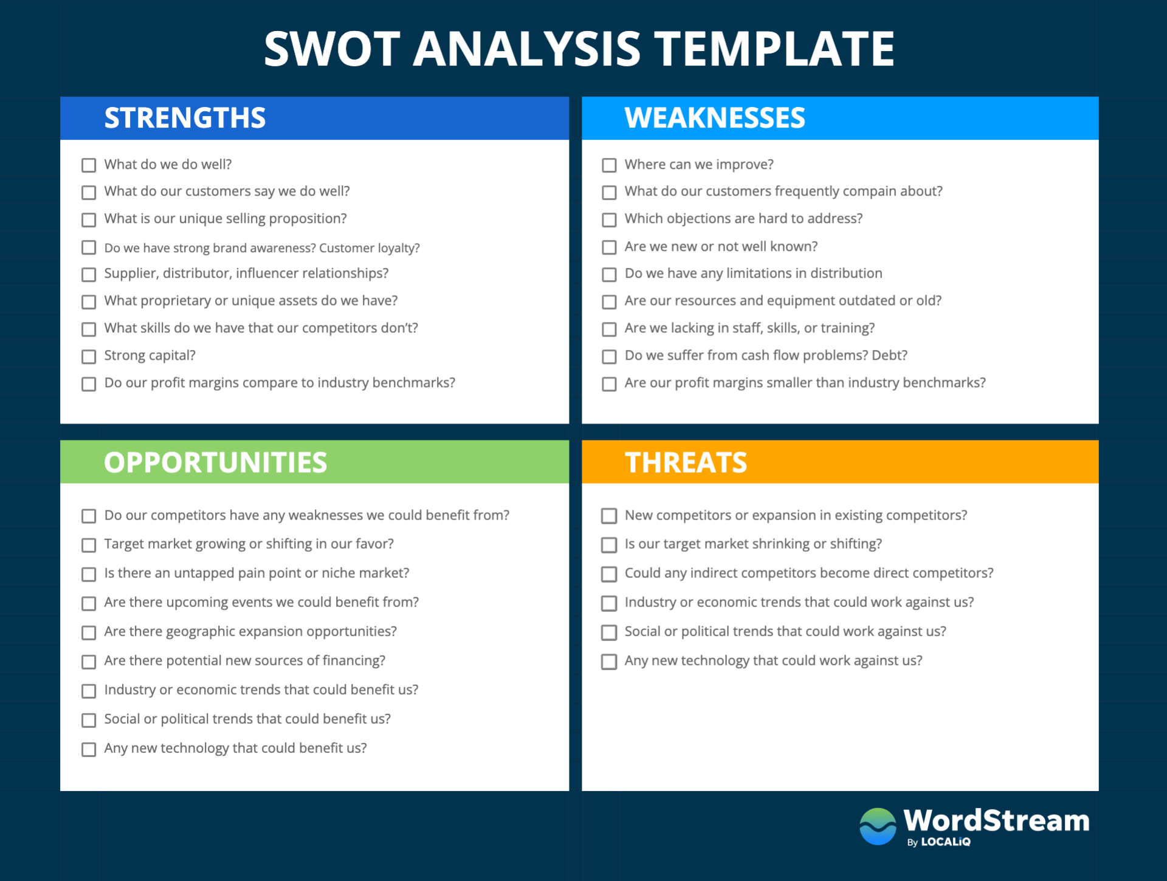

Slide 11
Church SWOT Analysis Template
STRENGTHS | WEAKNESSES
What do we do well? What do people like about coming here? What is unique about our worship/ministries? What is good about our community relationships? What does the community like about us? What do we do in the community that is appreciated by residents, city/county leaders, and other community advocates? What are the various skills/qualifications of our members that could be utilized to help people in our community? What positive experiences and events have we contributed to the benefit of our community that we could do again? Why would the community miss us? | How can we improve? What do our members complain about? What do our guests complain about? Are we not well known? Is our curb appeal not appealing? Are we struggling with financial resources? Do we not have enough skilled people to staff our ministries? Are we doing and funding “ministries” that have little or no impact on the community or our own members actual needs? Is another church doing the same things more effectively that we are struggling to do? Does or church have a “dug-in” determination to maintain traditions even when the need for change is obvious?

Slide 12
Church SWOT Analysis Template
OPPORTUNITIES | THREATS
Is our city/county growing in population? What upcoming community expansion plans could we benefit from to be relevant? Is there pain in our community that we could tap into to help bring about healing? Are there current or projected economic development plans that we can benefit from? Are there political and social issues or programs that we can get involved in, appropriately, to serve our community? Do we have immigrant Adventists in our church who can be drafted into the life and ministry of our congregation to help us reach immigrant communities? Are there committees and boards that some of our members can be urged to serve on? | Are there social or political trends that could work against our cause? Is another church planning to build or start near us? Is there a decline happening or forecasted in the population of our city/county or our target demographic? Are there hate groups in our city that pose any physical or political threat to the advancement of our cause?

Slide 13
Designing the Strategic Plan
The Church Board or a sub-committee of the Board could be asked to work on the plan
The Pastor or another qualified member chairs the committee
The results of the SWOT analysis will play a central role in the direction of the plan development
Elected ministry leaders weigh in by submitting ministry solutions to various trends and themes that emerge from the SWOT

Slide 14
Structure of the Strategic Plan
A strategic plan should have certain elements to promote success, namely:
S | Specific | Strategic objectives or goals should be clear and concise, eliminating as much as possible, the need for interpretation.
M | Measurable | A quantifiable way to track the progress of each goal’s implementation or each remedy’s application to the need.
A | Attainable | Setting realistic goals that we can achieve, based on our human and financial resources or opportunities for collaboration
R | Relevant | Must meet an actual need or solve a challenge! Time and resources should not be committed to simply “doing stuff”
T | Time-bound | When should this action be started, or completed, or evaluated?

