Slide 1


Strategic Planning:
Why It’s Important for Your Church
APRIL SMITH, MS, NBC-HWC
SAC WOMEN’S MINISTRIES DIRECTOR
WELLNESS STRATEGIST & COACH

Slide 2

WELCOME
EDUCATION
  BS in Public Health: Community Health Education
  MS in Recreation Administration
  Doctoral Candidate in Psychology
- Industrial and Organizational Leadership
  John Maxwell Leadership Team
  National Board Certified Health & Wellness Coach
EXPERIENCE
  Designed award-winning community health initiatives & worksite wellness programs for nonprofits, municipalities, & fortune 500 company
  Managed Community Health Coalitions
  Recipient of numerous health & wellness grants
  Provided technical assistance to funded partners
April Smith, MS, NBC-HWC
SAC Women’s Ministries Director
Wellness Strategist & Coach
asmith@sacsda.org

Slide 3


STRATEGIC QUESTIONS TO PONDER:
  What impact has your church made as a result of its efforts?
  2. If someone asked for evidence of impact, what would you show them? data, stories, etc.
  3. Does your ministries reflect the needs of today’s families?
  4. How do you currently know if a ministry is effective beyond attendance?
  5. Can your leaders, congregation, and community clearly articulate why each ministry exist and how they align with the church mission or are ministries running because they always have?
  6. Are funds and resources allocated because they align with church mission?
Notes:
“Can your leaders, congregation, and community clearly articulate why each ministry exists, or are some running simply because they always have?”
No. 5
The reason why is Clarity of purpose is the foundation of strategy.
If you don’t know why something exists, you can’t measure it, fund it, improve it, or decide if you need to do away with it.
• It exposes mission drift.
Many churches run ministries out of tradition, not impact.
This question forces alignment.
• It drives every other question.
• You can’t measure impact without purpose.
• You can’t show evidence without clarity on what you’re trying to accomplish.
• You can’t know if you’re meeting family needs without knowing the ministry’s intended purpose.
• You can’t allocate funds strategically if the ministry’s purpose is unclear.
• It unifies leadership.
When everyone knows the “why,” decision‑making becomes easier, faster, and healthier.
This question is the root system that feeds all the others.

Slide 4


THE REALITY MANY CHURCHES FACE
Common Challenges
  Busy church calendar with unclear priorities & little program impact
  Exhausted leaders and volunteers
  Multiple ministries operating in silos (no collaboration/brainstorming)
  Faithful activity without measurable outcomes
  Duplicated efforts competing for limited funds
  Declining attendance or disengaged younger generations with no well thought out plan in sight
A church can be busy but is it impactful?
Busyness Effectiveness
Notes:
We many have a lot of things happening at our church, but busyness does not always equal effectiveness especially when it comes to changing lives and behaviors and improving outcomes.
Most churches fail at addressing these challenges because they are over-functioning without alignment or well thought out intention.

Slide 5

WHAT STRATEGIC PLANNING IS (AND IS NOT)
Strategic Planning is:
  A prayerful, intentional process that aligns vision, mission, people, and resources
  A roadmap for decision-making and accountability that makes us good stewards of God’s resources and communicates to everyone what you intend to do and how you plan to get there
Strategic Planning is NOT:
  A corporate takeover of ministry
  A lack of faith
  A rigid box that limits or replaces the Holy Spirit
Notes:
Strategy does not replace faith - it stewards it.
God is not a god of chaos, He likes order - strategic enables us to do that

Slide 6

WHY STRATEGY MATTERS IN MINISTRY
“Suppose one of you wants to build a tower. Won’t you first sit down and estimate the cost?
Luke 14:28
God values thoughtfulness, order, and fruitfulness
Notes:
While this scripture is about discipleship, it emphasizes the importance of planning and considering the cost before undertaking a significant commitment.
Do we give careful in-depth thought to our ministries?

Slide 7

WHY STRATEGY MATTERS IN MINISTRY
“Moreover it is required in stewards that one be found fruitful”
1 Corinthians 4:2
Strategic Planning is stewardship because it is intentional management of what God has entrusted to us
  Vision (calling and assignments)
  People (souls, gifts, volunteers)
  Resources (finances, facilities)
  Opportunities (community influence and needs)
In being strategic, we are able to meet the needs of God’s people, produce fruits and not be wasteful
Notes:
While this scripture is about discipleship, it emphasizes the importance of planning and considering the cost before undertaking a significant commitment.
Do we give careful in-depth thought to our ministries?

Slide 8

BENEFITS OF STRATEGIC PLANNING FOR CHURCHES
  Clear focus & direction that reduces burnout & confusion
  Better stewardship of time, money, and volunteers
  Effective well thought-out church & community initiatives
  Stronger partnerships and funding opportunities
  Better communication and promotion of programming
  Greater credibility in the community
  Tangible transformation, not just attendance growth
  Church unity in shared vision, mission, and strategy
Notes:
United Way didn't abandon generosity - they focused it. Churches can do the same.

Slide 9
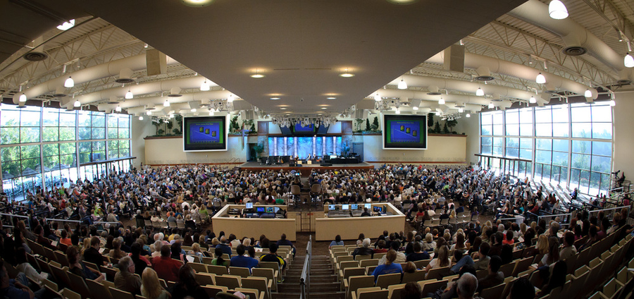
CASE STUDY: SADDLEBACK CHURCH
In the early 2000s, Saddleback recognized that:
• programs were multiplying
• volunteers were burning out
They needed a unified, strategic framework that aligned every ministry with mission and measurable impact.
Saddleback reorganized the entire church around five strategic purposes:
1. Worship
2. Fellowship
3. Discipleship
4. Ministry
5. Mission
  ministries were disconnected
  community needs were growing
Notes:
The church realized that traditional ministry alone would not meet the city’s needs. They created a center of hope and services

Slide 10
CASE STUDY: SADDLEBACK CHURCH
Every ministry had to:
• articulate its purpose
• align with one of the five
• define measurable outcomes
• demonstrate community impact
This eliminated “just-because ministries” and clarified why each ministry existed
Conducted a community needs assessment and discovered these needs:
• mental health
• food insecurity
• homelessness
• unemployment
• spiritual disconnection
Notes:
The church realized that traditional ministry alone would not meet the city’s needs. They created a center of hope and services

Slide 11
CASE STUDY: SADDLEBACK CHURCH
Strategic Ministry Launches
Based on the assessment, Saddleback launched or expanded:
• The PEACE Center (food pantry, job training, legal aid, counseling)
• Celebrate Recovery (now a global ministry freeing people of hurts, hangups & habits)
• Mental Health Ministry (post‑Purpose Driven Life)
• Neighborhood small groups that served local needs
Each ministry had:
• a clear purpose
• defined outcomes
Saddleback shifted from “funding programs” to funding purposes.
Ministries that aligned with mission and demonstrated impact received priority.
Serve over 30,000 people annually (2024)
• volunteer pipelines
• evaluation metrics
Notes:
The church realized that traditional ministry alone would not meet the city’s needs. They created a center of hope and services

Slide 12

STRATEGIC PLANNING MEETS THE NEEDS OF PEOPLE
Strategic Planning challenges churches to give thought to how the needs of people are being met and how the church can utilize its resources to meet these needs:
Current national issues/hot topics:
  Mental health & emotional wellbeing
  Loneliness & community disconnect
  Spiritual formation that goes beyond programs (discipleship pathways, whole-life faith, spiritual practices)
  Reaching & retaining young adults
  Family support & parenting pressure
  Economic stress & financial instability
  Health disparities & whole-person wellness
  Digital discipleship & hybrid ministries
  Leadership development & succession
Notes:
United Way didn't abandon generosity - they focused it. Churches can do the same.

Slide 13
STRATEGIC PLANNING CHALLENGES YOU TO ASK IMPORTANT QUESTIONS
QUESTIONS: STRATEGY & IMPACT
Does your church ministries reflect the needs of today’s families?
What problems in your community have improved as a result of your church?
What problems in your community would be worst if your church no longer exist?
Can your church clearly articulate why each ministry exist or are some running because they always have?
Are your funds and resources allocated because they align with church mission?
How do you currently know if a ministry is effective beyond attendance?
What fruits are you expecting God to grow through your efforts and are you watching/measuring for it?
If someone asked you for evidence of impact, what would you show them: stories, data, both?

Slide 14
STRATEGIC PLANNING CHALLENGES YOU TO ASK IMPORTANT QUESTIONS
QUESTIONS: VOLUNTEER & LEADERSHIP
  Are your volunteers energized by purpose and mission or exhausted by obligation?
  Are you developing leaders or depending on the same faithful few?
  Does your current approach to ministry promote longevity or burnout?
QUESTIONS: FUTURE FOCUSED
  If God increases your impact by 50%, would your current structure support it or collapse under it?
  Are you planning for growth or praying for it without preparation?

Slide 15

CALL TO ACTION
Be the church that
  Knows exactly why you do the things you do, where you’re going, and how you’re going to get there
  Measures fruits, not just effort
  Aligns spiritual formation with community transformation
  Confidently communication your plan
  Leave a lasting legacy
What kind of impact do you want your church to make in the
lives of the people you serve in your church and communty?
“Write the vision, make it plain”
Habukkah 2:2
Notes:
United Way didn't abandon generosity - they focused it. Churches can do the same.

Slide 16









QUESTIONS
April Smith, MS, NBC-HWC
SAC Women’s Ministries Director
Wellness Strategist & Coach
asmith@sacsda.org
336-830-4343
@AprilSmithWellness

